Slide 1



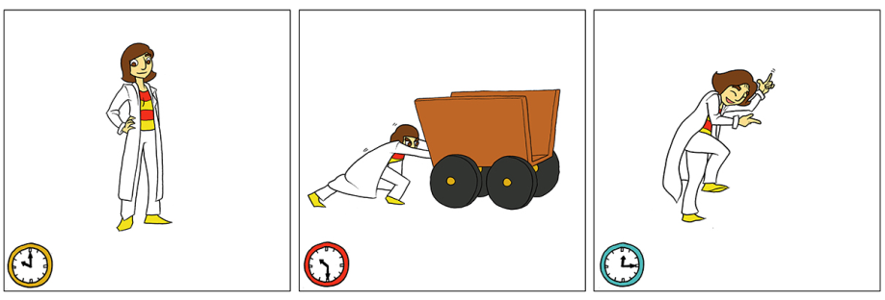
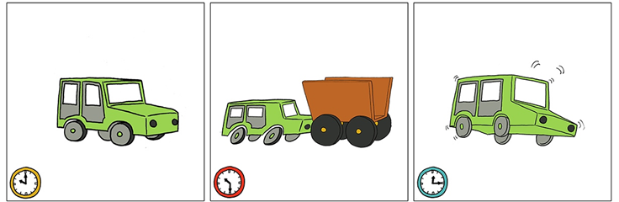
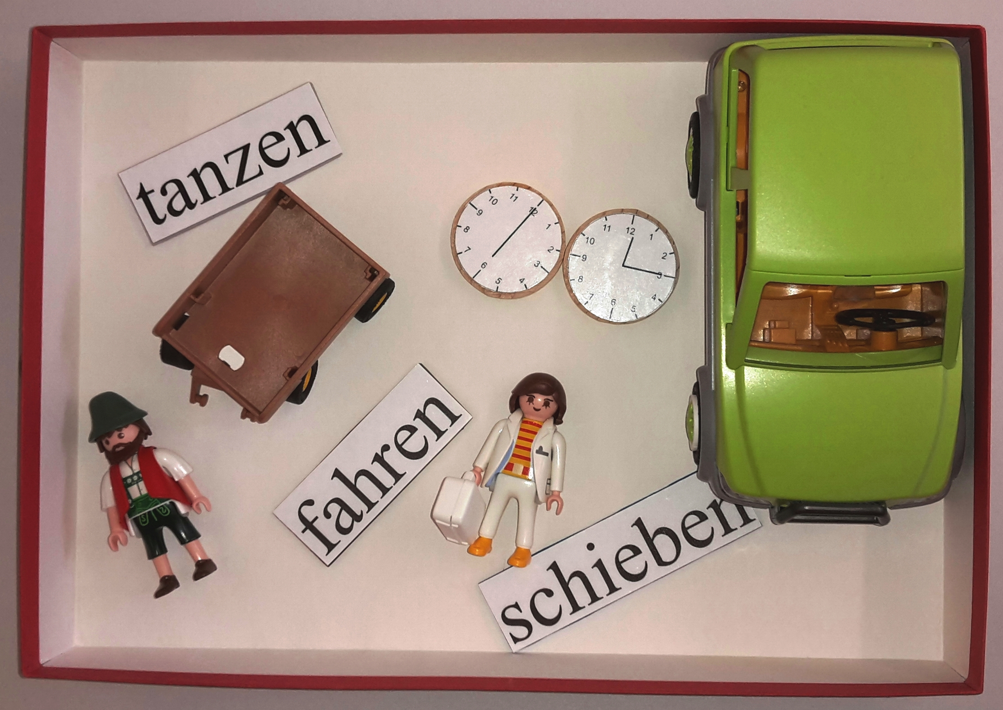
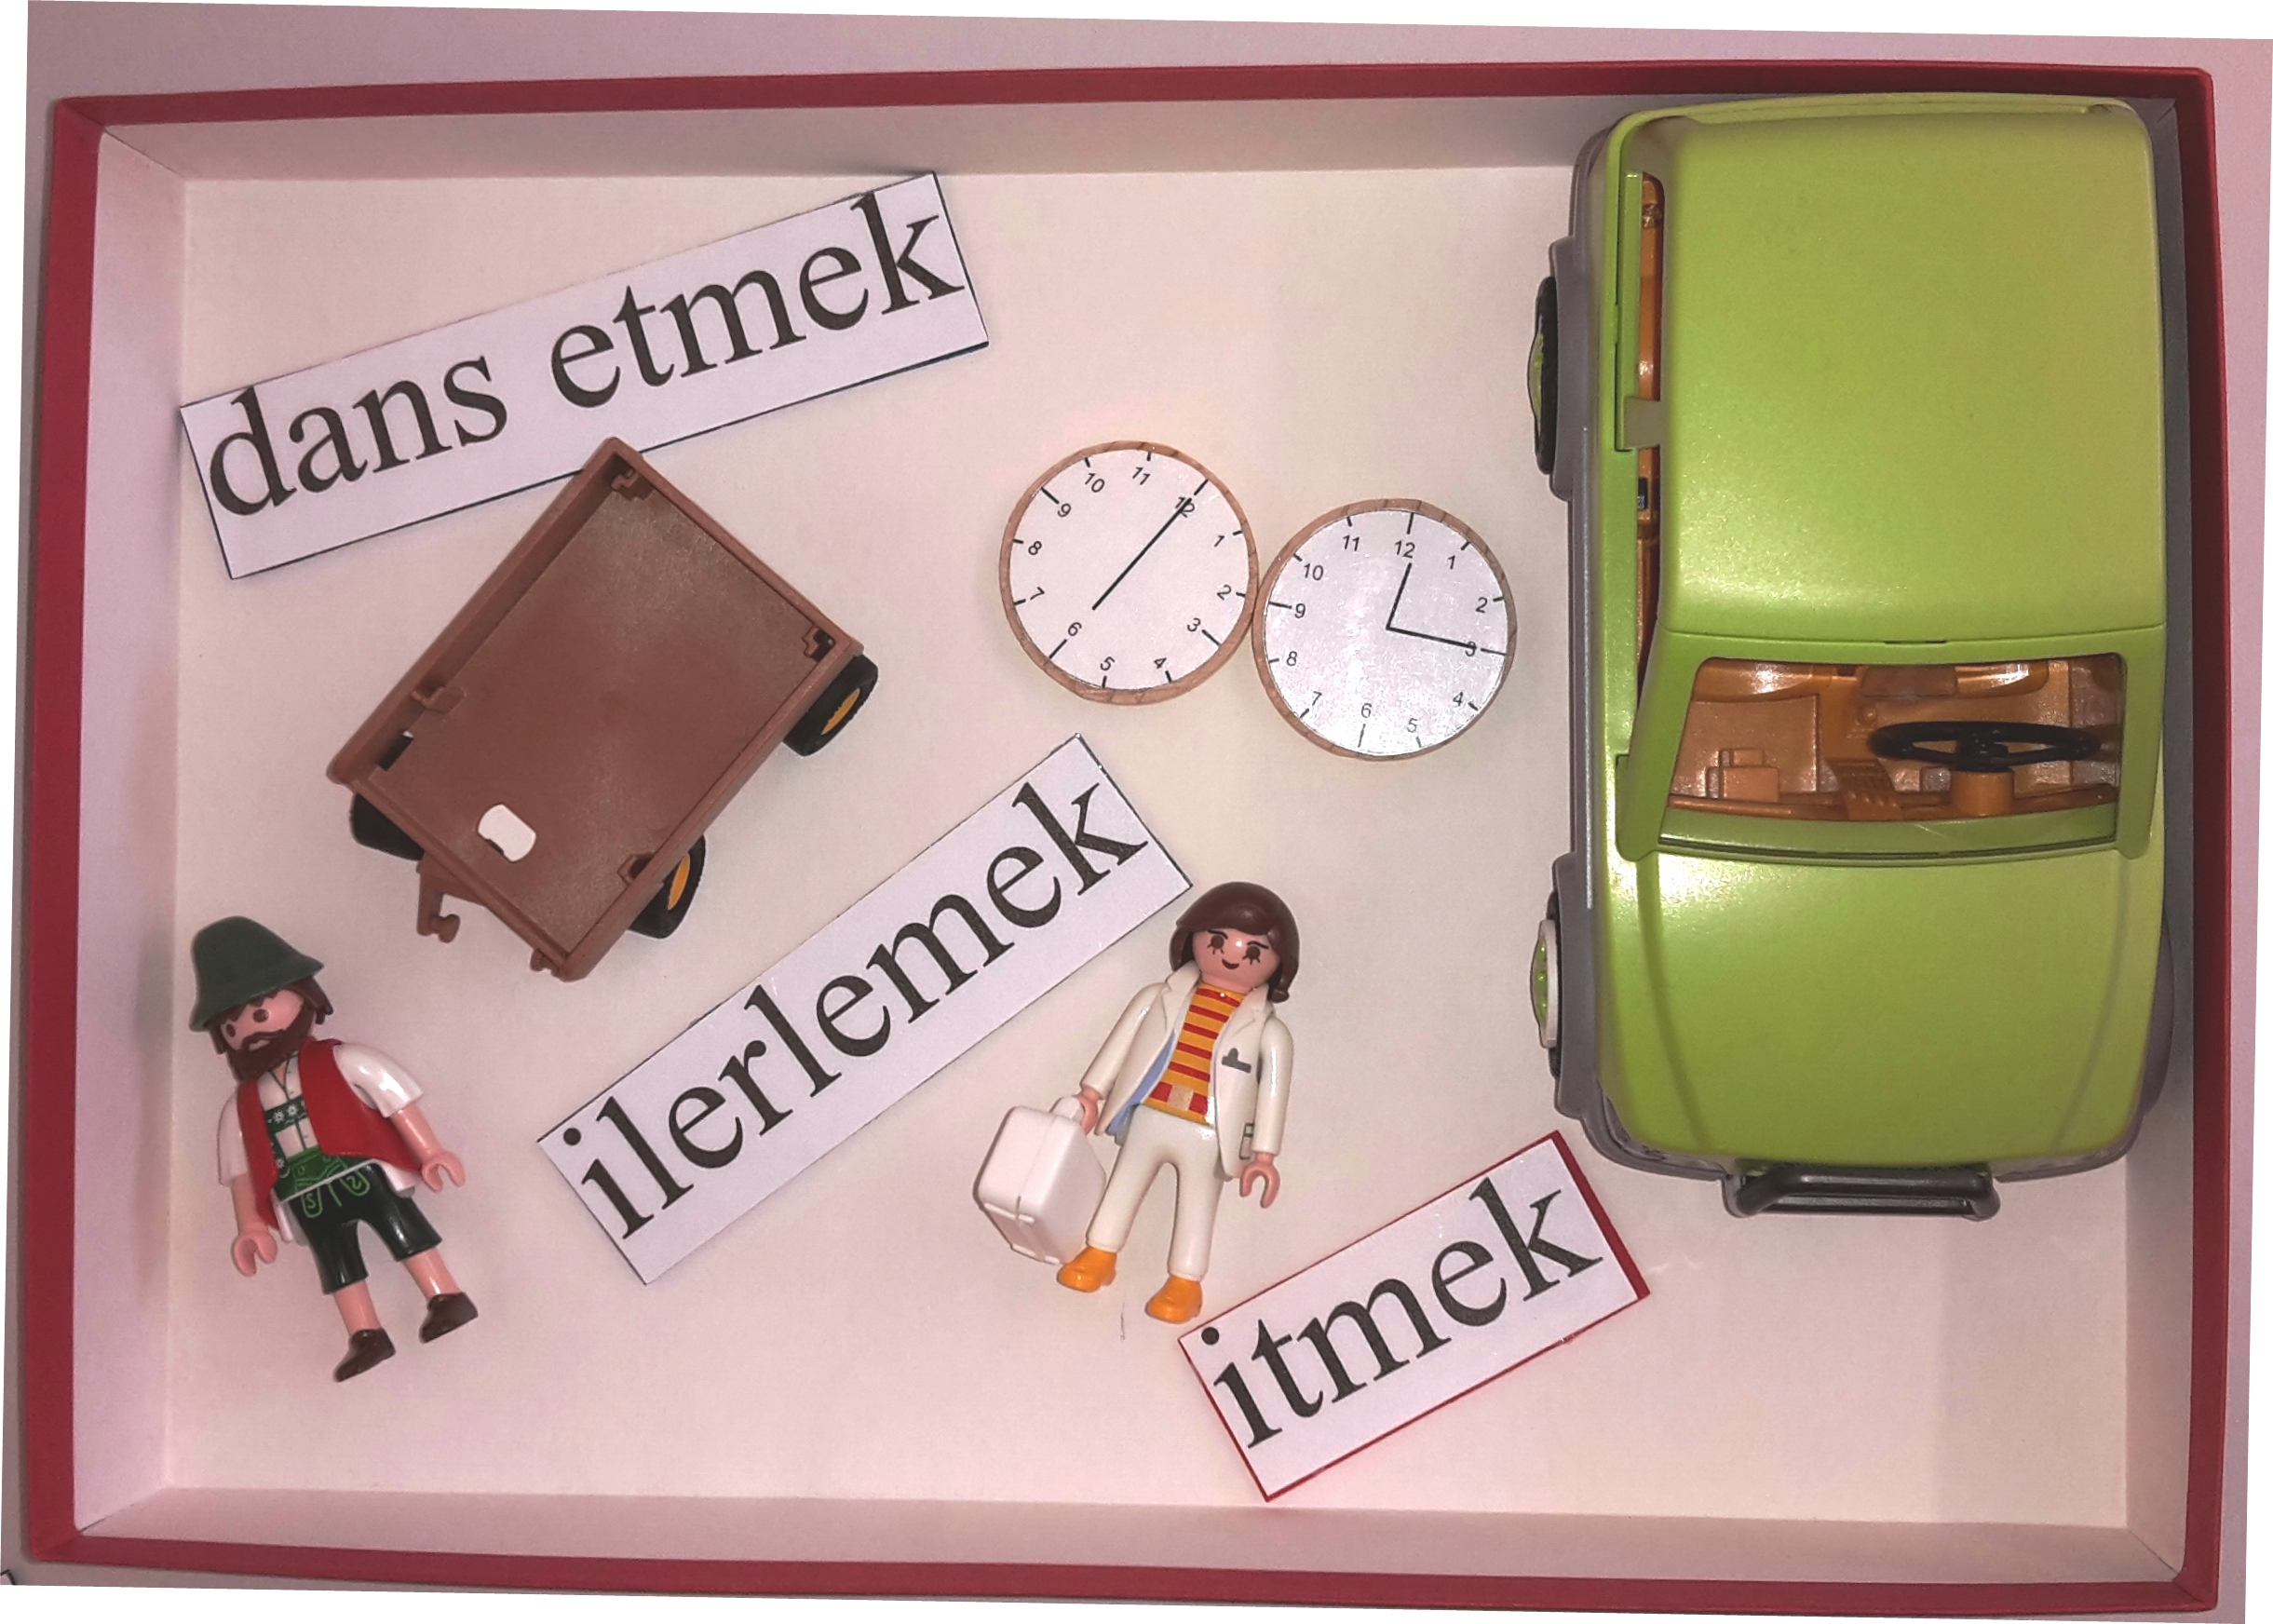
Language-specific and language-independent serialisation patterns for framesetters, topics, and predicates
Heike Wiese, Eva Wittenberg & Mehmet Tahir Öncü
heike.wiese@uni-potsdam.de ewittenberg@ucsd.edu mtoncu@yahoo.com
THE NATURAL ORDER OF INFORMATION
Many studies have shown language-independent preferences for the serialisation of thematic roles (Goldin-Meadow et al., 2008; Futrell et al., 2015; Hall, Mayberry, & Ferreria, 2013; Hall, Ferreira, & Mayberry, 2014; Langus & Nespor, 2010, et al.) → Do such preferences extend to information structure? → relative order of framesetters and topics with respect to their predication.
Background: While topics specify the entity under which a proposition is to be stored, framesetters provide specifications – typically time or place – restricting the domain in which the proposition is valid.
Prediction: Topics and Framesetters will be preferred in initial position, before the predication itself, regardless of language-specific word orders.
SYN
adverbial > subject
frame/link > topic
IS
TIME > PERSON
SEM
ENGLISH WORD ORDER:
-SVO-language
-S > V > Adv(Zeit, Ort) > O
-Subjekte, Topik- and Fokus
GERMAN WORD ORDER:
-SVO-language
-S > V > Adv(Zeit, Ort) > O
-Subjekte, Topik- and Fokus
TURKISH WORD ORDER:
-SOV-language- free word order
-S > Adv(Zeit, Ort) > O > V
-Topik – Fokus – [Verb]
TWO STUDIES: COMPARING LINGUISTIC AND SEMI-VERBAL ORDERING PREFERENCES
ACT-OUT STUDY
Framed as communication game
20 short stories in comic strip, invisible to confederate:
Topics: same central actor across a story
Framesetters: clocks
Task: act out 3rd picture of comic strip (intransitive action executed by the topic) semi-/nonverbally, with ‘playmobil’ figurines, wooden clocks, and printed verbs.
Subjects:
monolingual English, N=34
monolingual German, N=35
monolingual Turkish, N=30
Prediction: Topics/Framesetters > Actions
VERBAL DESCRIPTIONS
after each act-out run
Task: describe 3rd picture of comic strip verbally in native language
Prediction: Language-specific word order
RESULTS
RESULTS PER GROUP
act-out results
COMPARING LANGUAGES
ENGLISH
ACT-OUT: Vmid > Vlast > Vfirst
VERBAL: Vmid > Vlast
comparing the two tasks: χ²= 24.8, df = 2, p < .0001
VERBAL TASK:
GERMAN
ACT-OUT: Vlast > Vmid > Vfirst
VERBAL: 100% Vmid
comparing the two tasks: χ²= 508.7, df = 2, p < .0001
NONVERBAL TASK:
semiverbal results
TURKISH
ACT-OUT: Vlast > Vmid > Vfirst
VERBAL: Vlast > Vmid
comparing the two tasks: χ²= 65.3, df = 2, p < .0001
CONCLUSIONS
verbal descriptions followed different language-specific word orders.
in the extra-grammatical task, in addition to language-specific effects, we found a strong overarching pattern where speakers placed framesetters and topics before the verb → information-structural preferences can violate language-specific restrictions
findings point to information-structural patterns that are independent of, and interacting with, language-specific grammatical constraints.
We would like to thank Suhas Arehalli and Oliver Bunk for assistance in collecting the data. This work was supported by a German Academic Exchange Service (DAAD) postdoctoral scholarship to Eva Wittenberg, and SFB 632, Projekt B6 (grant to Heike Wiese).

